Slide 1
NAAN MUDHALVAN ASSIGNMENT
By
U. Alagu Anandhi
(921420108001)
RVS EDUCATIONAL TRUST’S GROUP OF INSTITUTIONS ,DINDIGUL

Slide 2
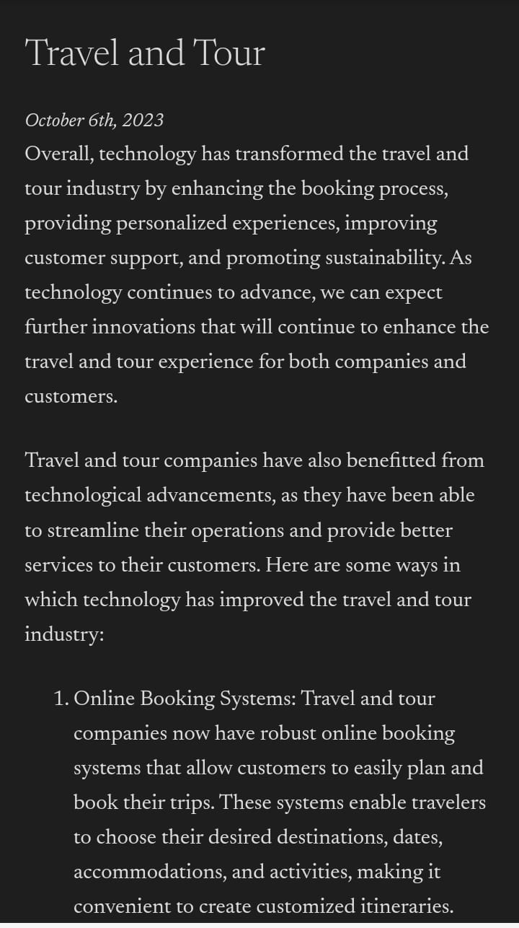
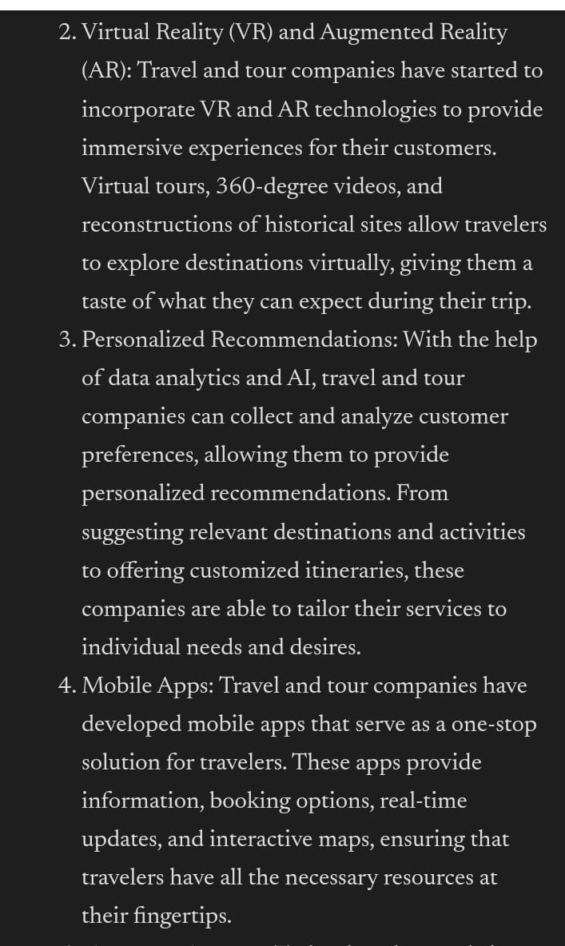
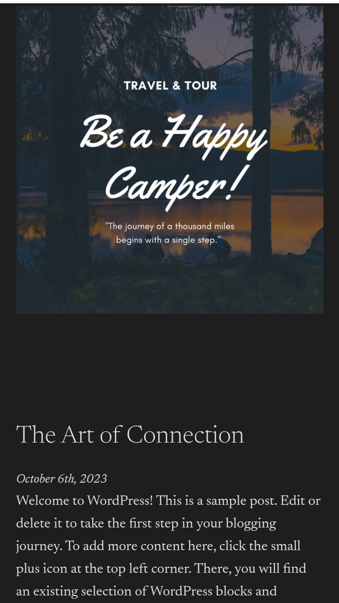
1.Creating A website using WordPress and post new article
ananthi2002alagu9.wordpress.com(opens in a new tab)

Slide 3

2.CREATE A NEW FACEBOOK BUSINESS PAGE AND POST ONE SOCIAL MEDIA POSTER FOR YOUR BRAND
https://www.facebook.com/61552124760109/posts/pfbid0wDcLXkPzuySE3nqhpvQouGsKztyfMhkyJisPv1iUxZJ7gADp8HHRdNtjfhufnqLZl/?app=fbl

Slide 4

3.Create and design a social media ad poster using Canva

Slide 5
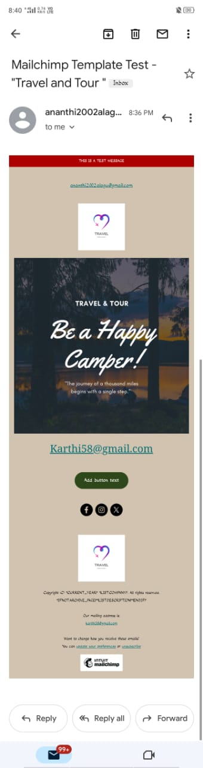
4.Create E-mail newsletter Design using Mailchimp

